Slide 1
Autonomous Truck Platooning
By
Asm Nurussafa
Tasawar Siddiquy
Arfat Kamal

Slide 2
Agenda
Introduction
Modelling Diagrams
Scenarios
Timed Automata
Machine Learning Algorithm
7. Simulation
Summary

Slide 3
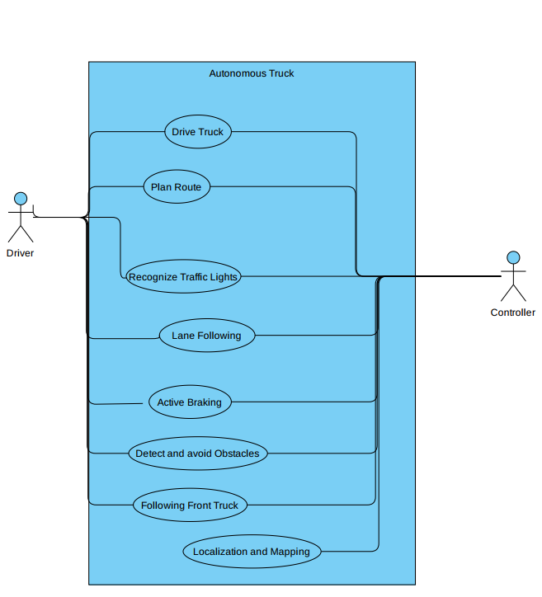
Use-case Diagram

Slide 4
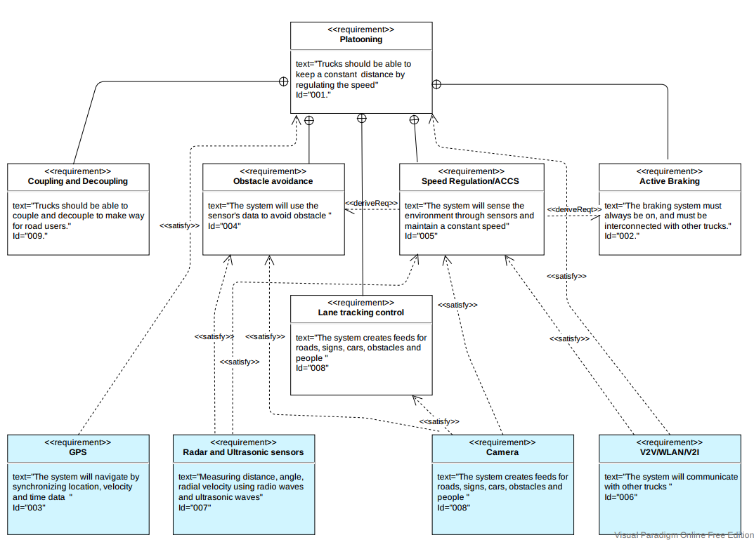
Requirements Diagram

Slide 5
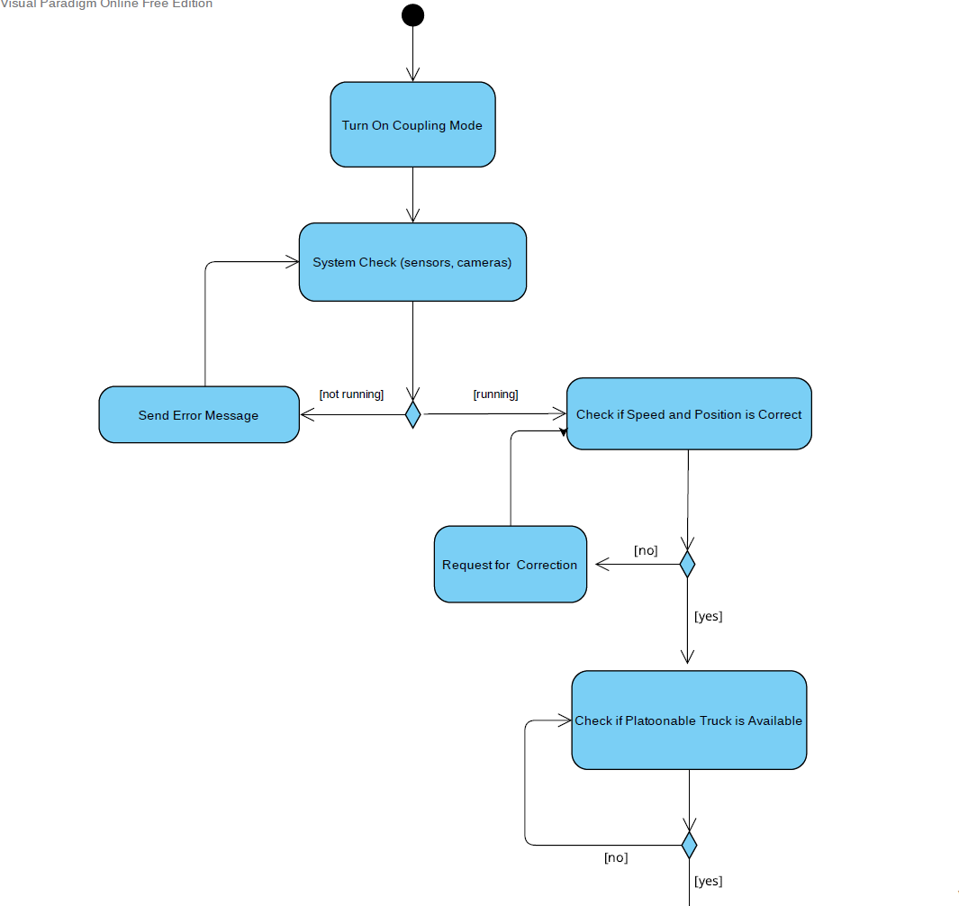
Activity Diagram

Slide 6
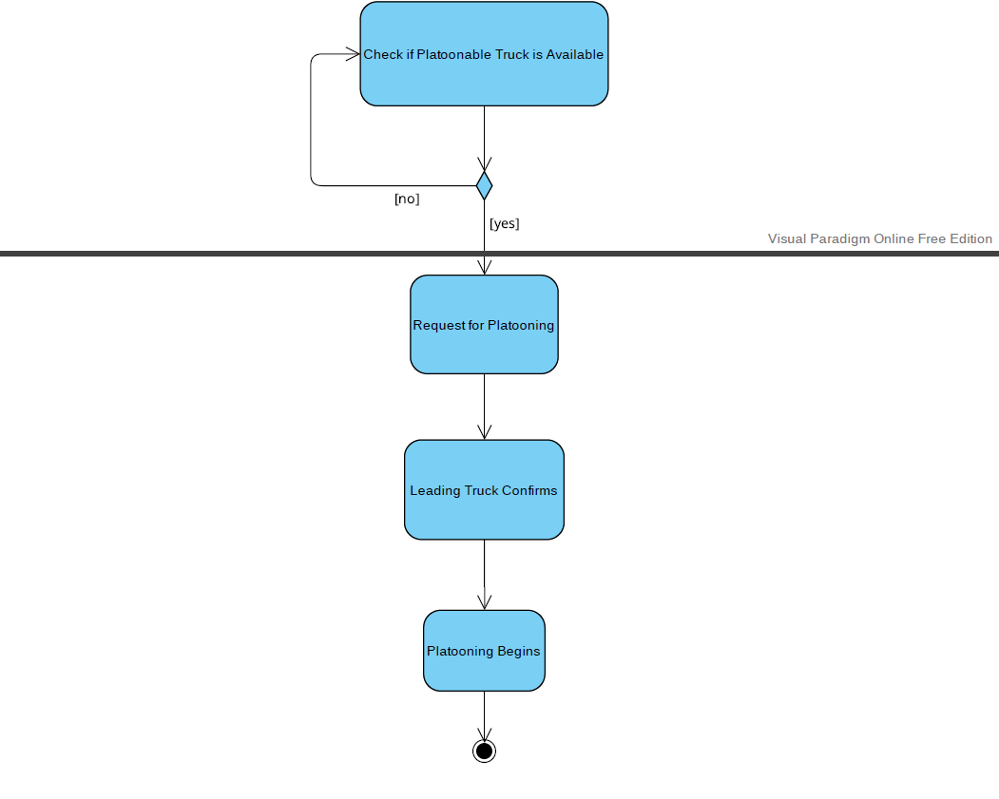
Activity Diagram

Slide 7
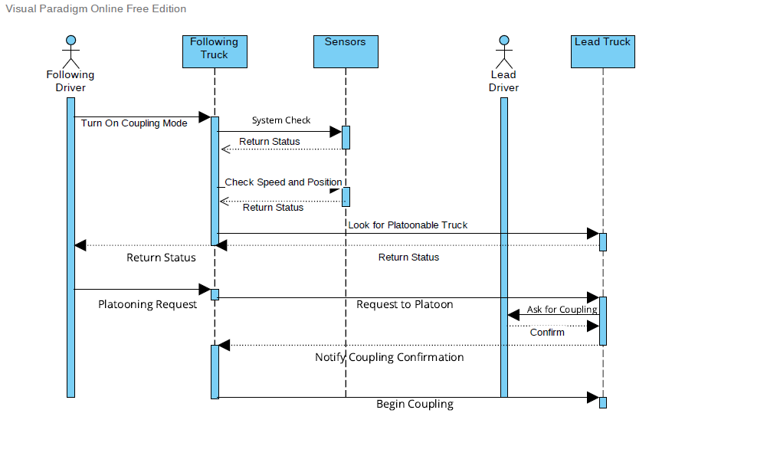
Sequence Diagram

Slide 8
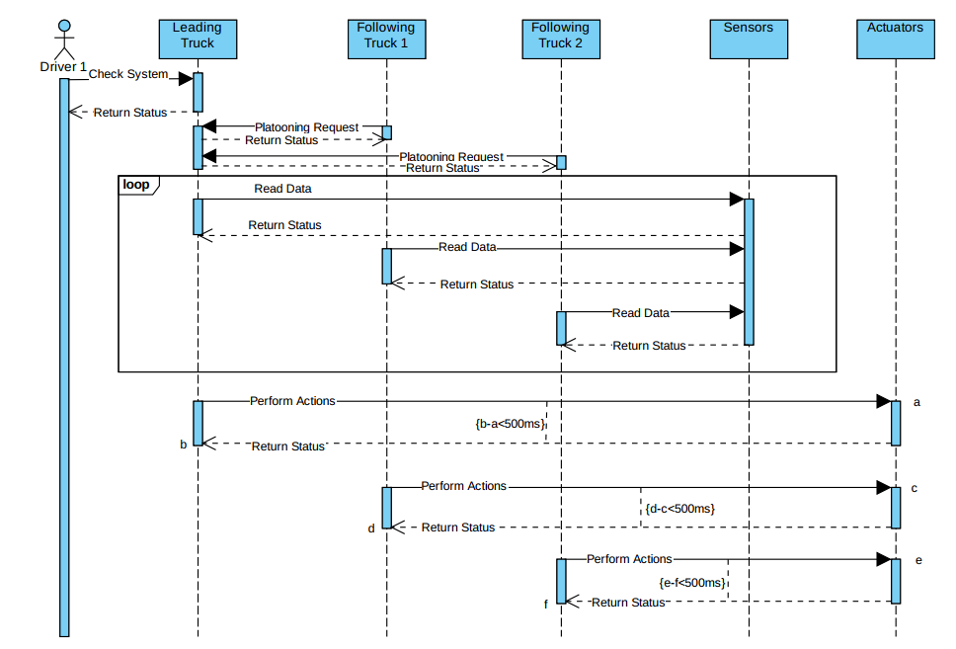
Scenarios- Maintaining Constant Distance

Slide 9
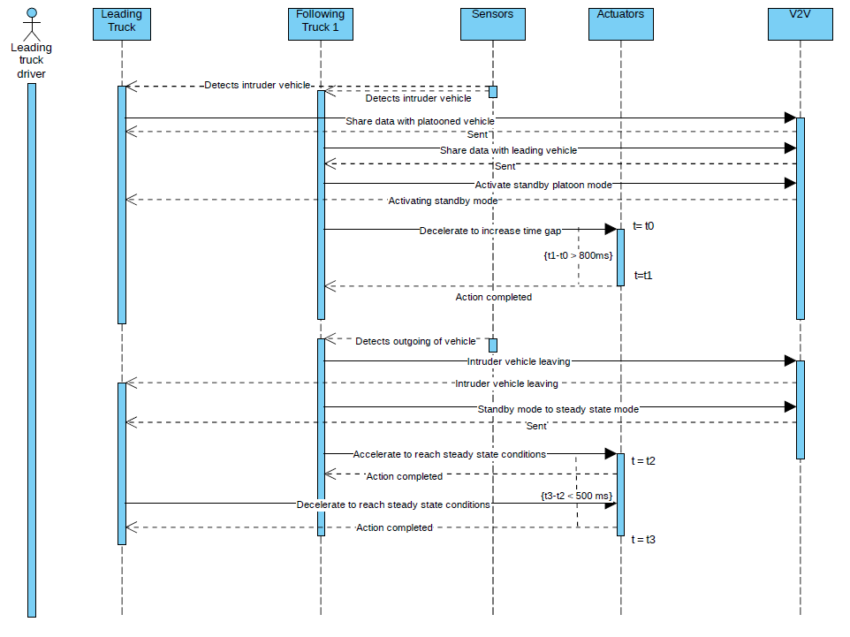
Scenarios- Intruder-Sequence Diagram

Slide 10
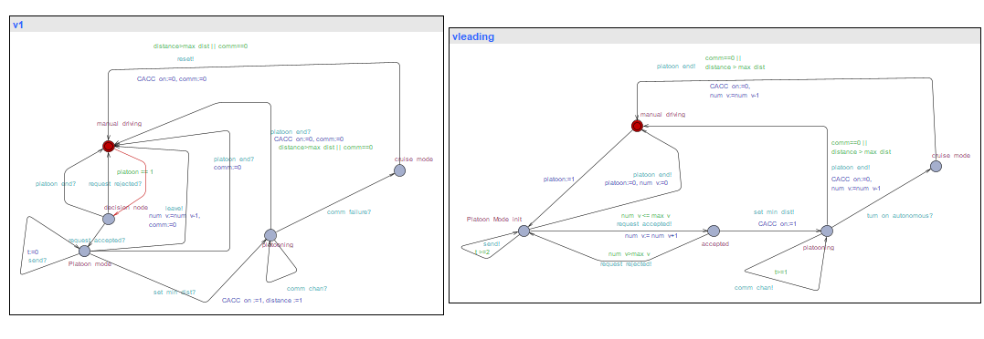
Timed Automata Platooning

Slide 11
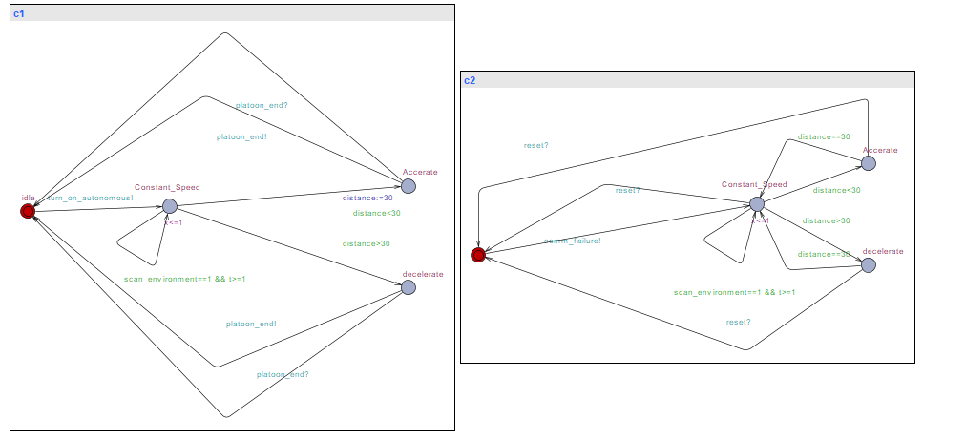
Timed Automata Maintaining Distance

Slide 12
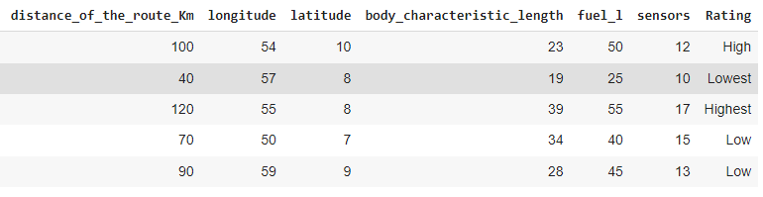
Machine Learning Algorithm

Slide 13
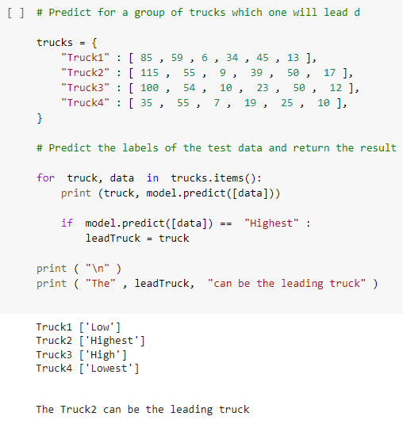
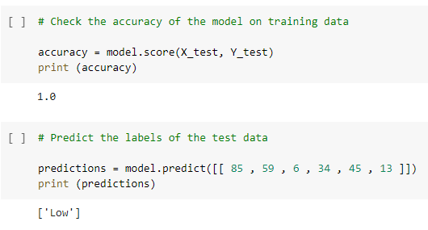
Decision Tree

Slide 14
6. Simulation
Simulation steps using Sumo- Simulation of Urban Mobility
Create a .net.xml using Net-Edit.
Create a .sumocfg file.
Create a .rou.xml file.
Create a .add.xml file.
Interface TraCI with python script.
Simpla to enforce platooning.

Slide 15
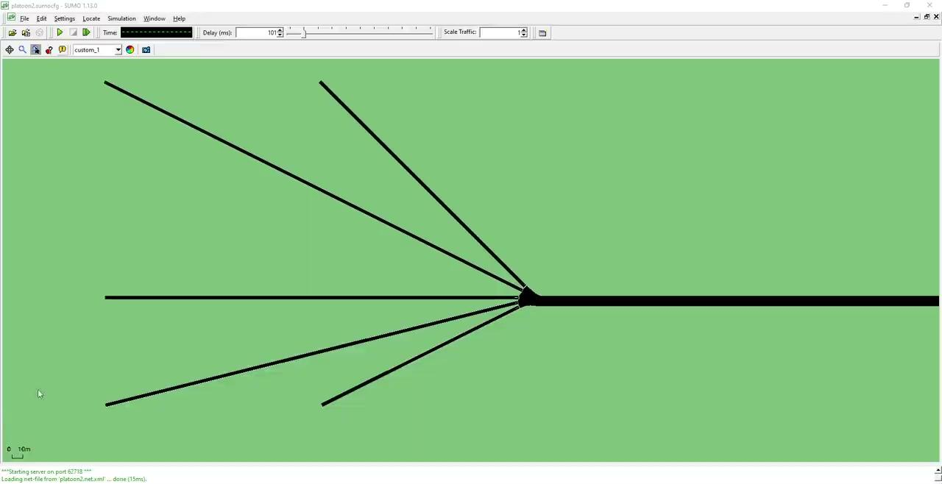
6. Simulation - Without Platooning

Slide 16
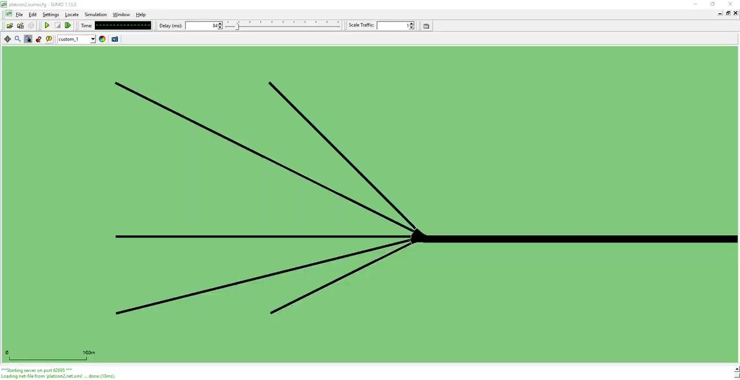
6. Simulation - Platooning

Slide 17
10. Summary
So what did we learn ?
How can we model such scenarios?
How can we implement the scenarios in Timed Automata?
How can we implement Machine learning algorithm?
How can we simulate such scenarios in SUMO Simulator

Slide 18
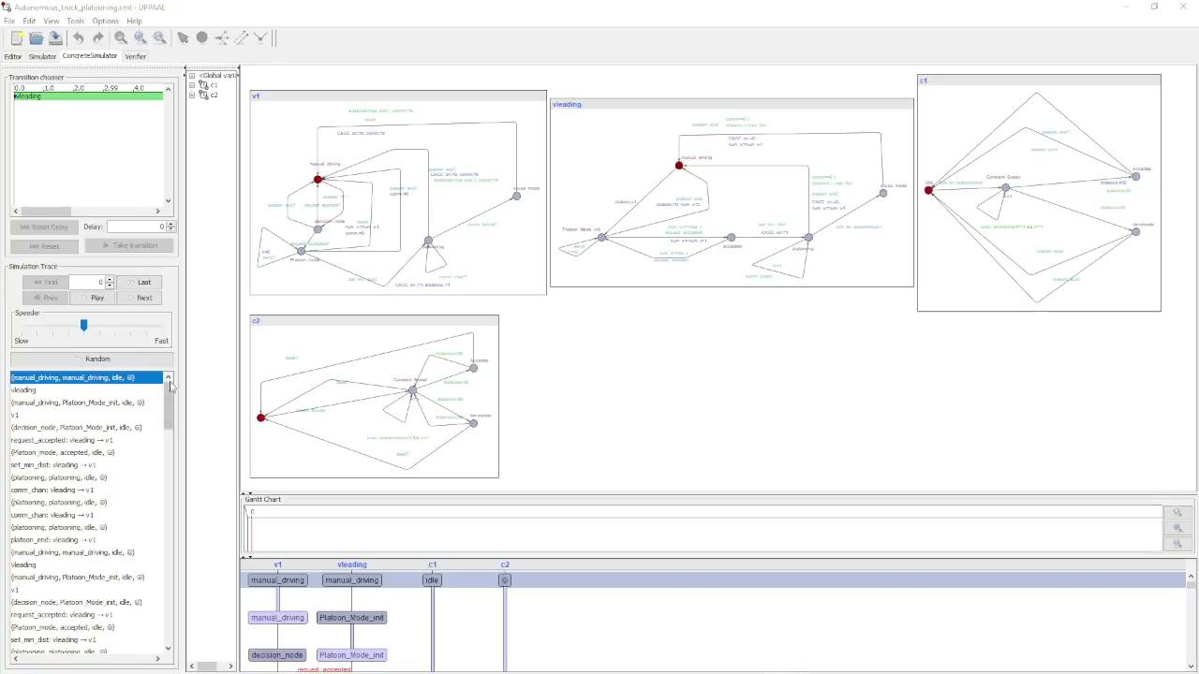
Timed Automata

